Slide 1
Daily_Report Analysis
File created on: 14-06-2020 00:14:34

Slide 2
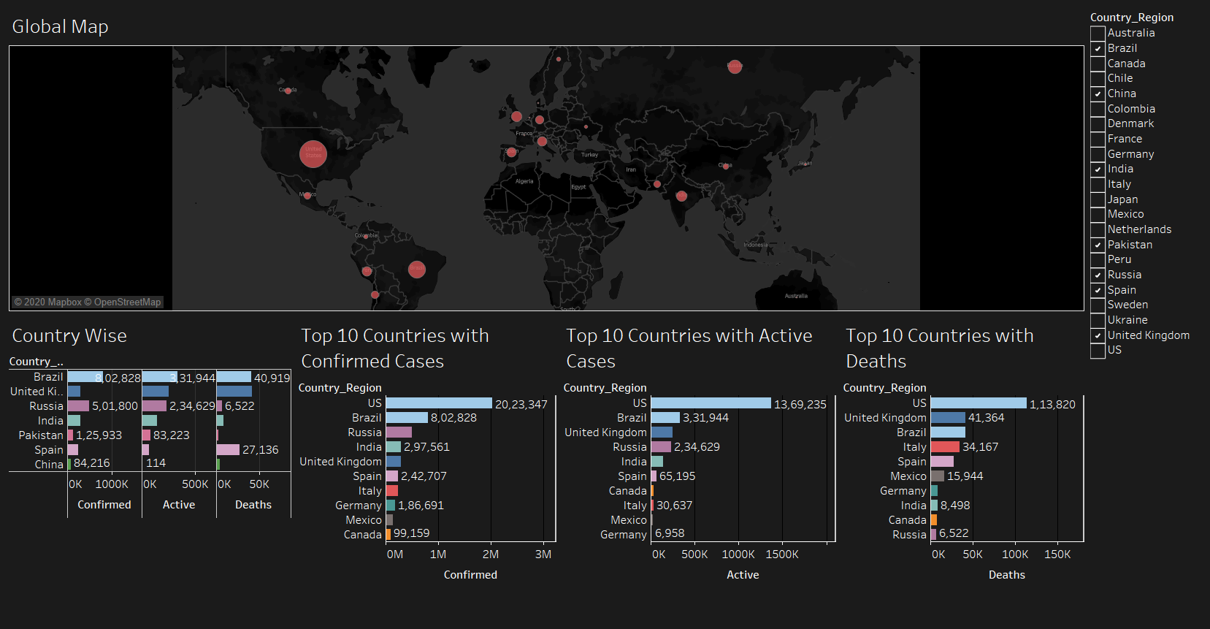

Slide 3
